Slide 1


ECEN 403 Status Update
Team Number: Home Power Monitor 2 Kim, Caiden, Josh, Vivek, Lawson
TA: Vishwam

Slide 2
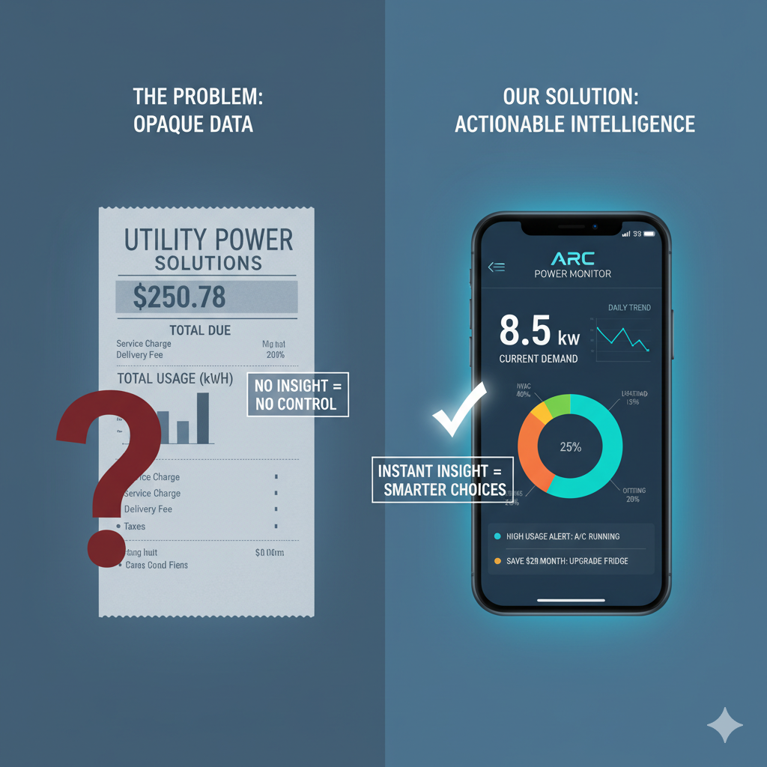
Project Summary
Problem:
Homeowners can only see their total electricity usage from utility meters, not what individual appliances are consuming.
Without device-level data, it's difficult for people to identify the main sources of energy waste and find effective ways to lower their utility bills.
Solution:
Analyzing the home's main power lines to identify the unique electrical signature of each active appliance in real-time.
Displaying a simple, device-by-device breakdown of energy consumption on a mobile app, empowering users to reduce waste and save money

Slide 3
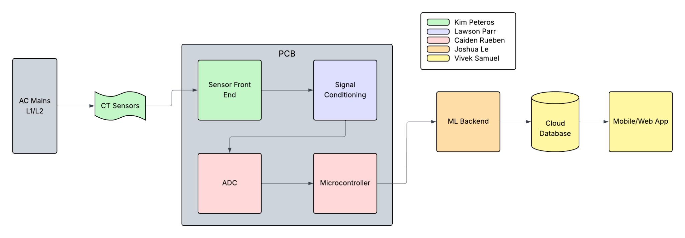
System Overview
Notes:
Cloud server and database

Slide 4
Sensor Front End
Kim Peteros
Accomplishments since midterm update ~36 Hours | Ongoing progress/problems and plans until the next presentation
Zeners, TVS, Resistors, Capacitors and CT clamps ordered. Circuit simulation to ensure it has a clean output signal with a ≤ 1.65 Vpk PCB designed and submitted for fabrication. | Soldering components to PCB and ensuring proper installation. Testing and ensuring CT clamp is sensing current properly and PCB is outputting a clean and stable signal with a ≤ 1.65 Vpk.

Slide 5
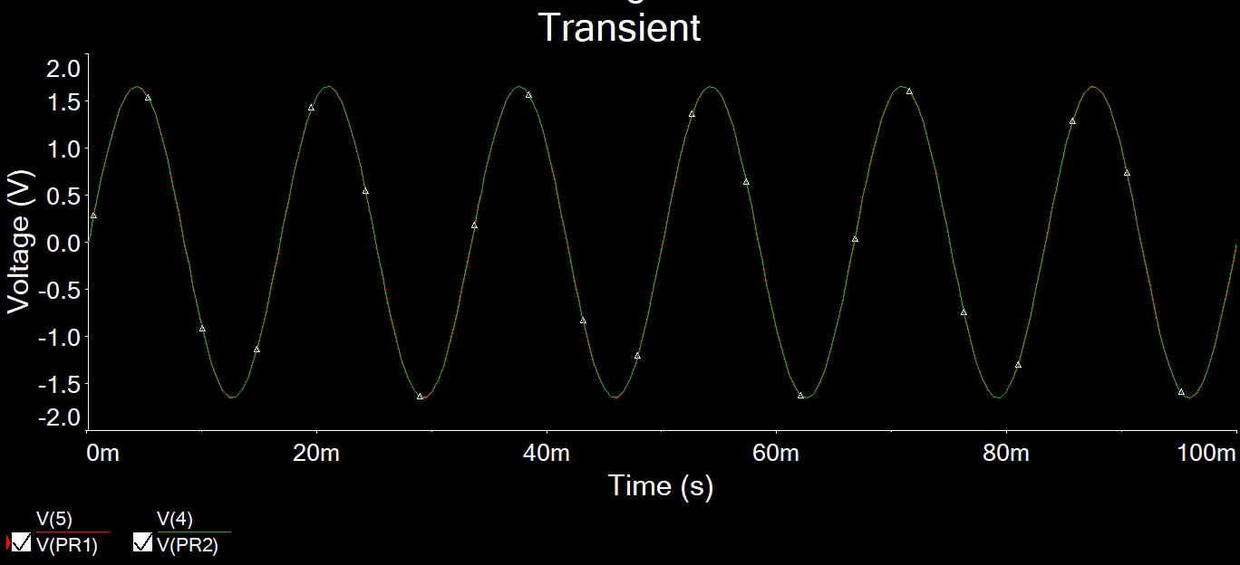
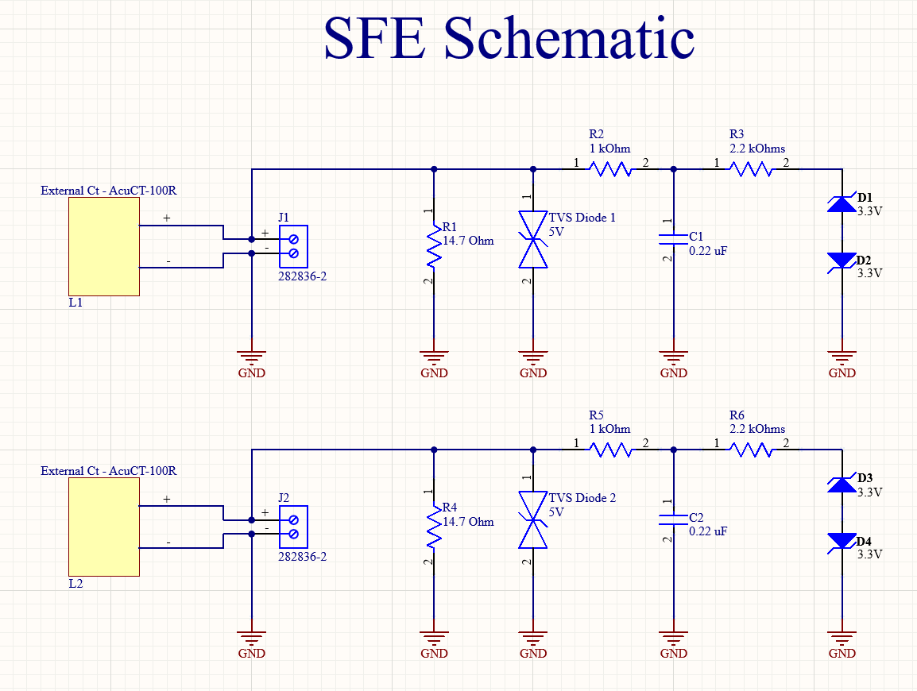
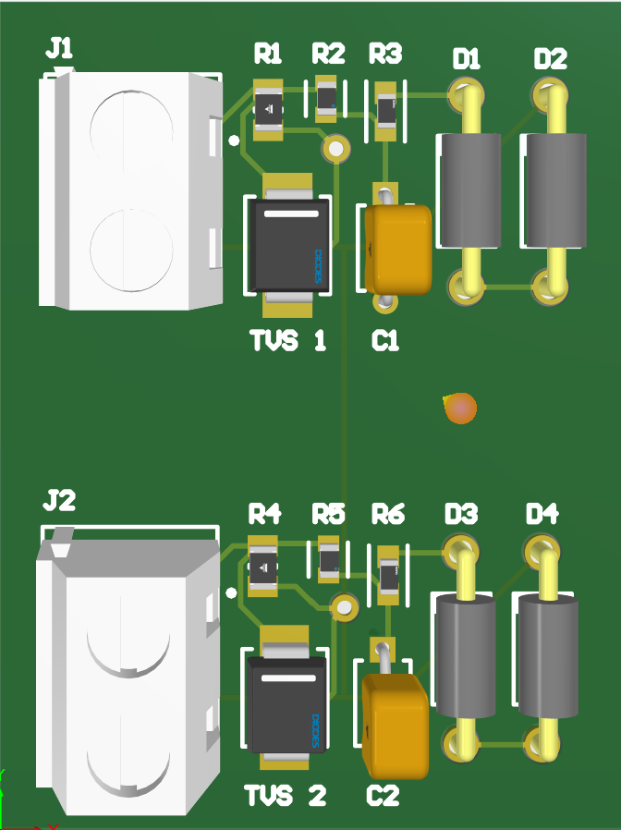
Sensor Front End
Kim Peteros
Multisim:
Multisim simulation using a 1:2500 transformer and exact model components.
Current source was set to 200A to simulate a full load on a main breaker line
Output signal was a clean and stable and has a ≤ 1.65 Vpk.
Altium:
2 circuits to allow for use of 2 separate CT clamps.
Terminal blocks were added to allow for safe mounting of CT leads.
Compact design to lower costs and noise.

Slide 6
Signal Conditioning
Lawson Parr
Accomplishments since midterm update ~28 Hours | Ongoing progress/problems and plans until the next presentation
Completed full testing on multisim of my schematic to verify correct operation of all three stages: biasing, buffering, and filtering. Producing a clean centered 0–3.3 V waveform. Transferred validated schematic design into Altium Designer and found exact parts to fit my design and ordered the parts on digikey. Completed PCB layout and routing. Generated Gerber files and placed the PCB order for fabrication. | Awaiting arrival of manufactured PCB for assembly and soldering of components. Plan to test the physical PCB to confirm proper biasing voltage, op-amp behavior, and filter performance.

Slide 7
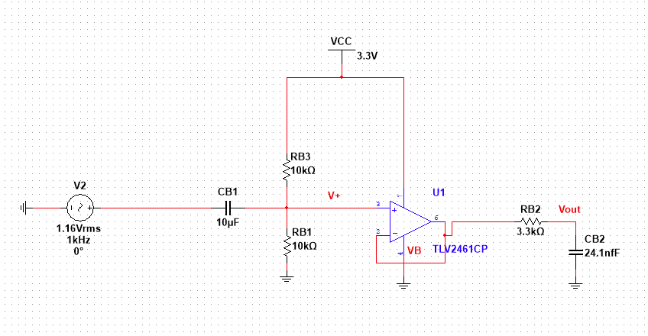
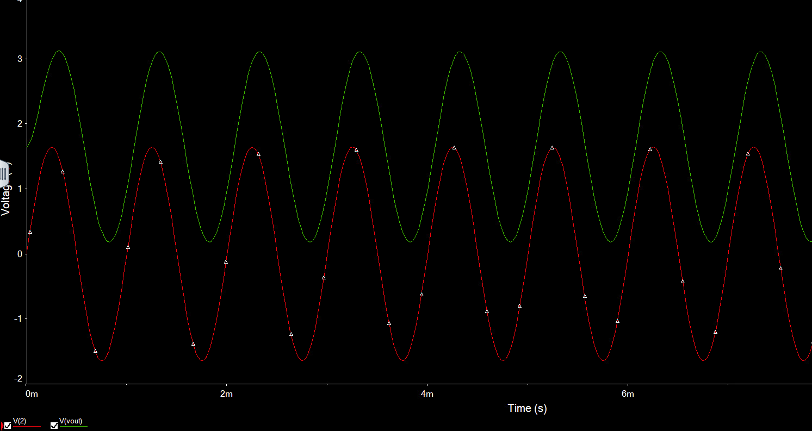
Signal Conditioning - Multisim
Lawson Parr
Schematic
Waveform

Slide 8
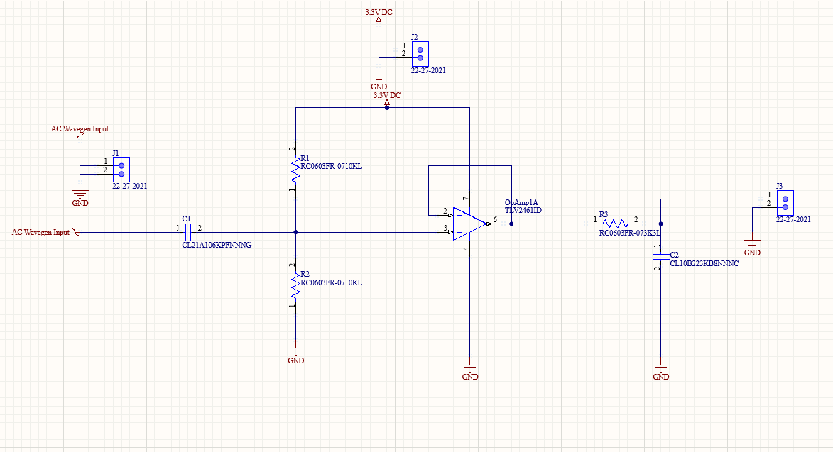
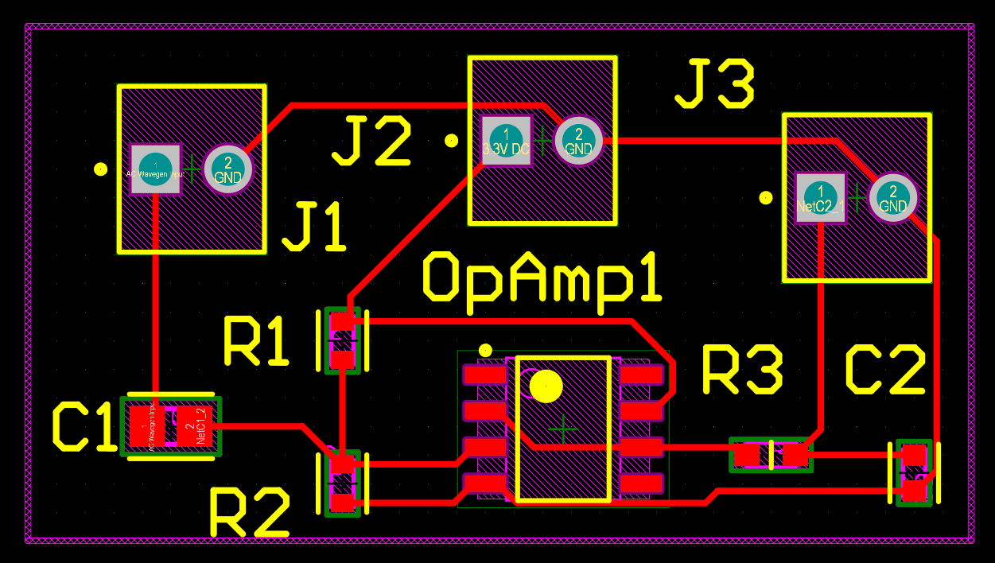
Signal Conditioning - Altium PCB
Lawson Parr
Schematic
PCB

Slide 9
Embedded Systems
Caiden Rueben
Accomplishments since midterm update ~33 Hours | Ongoing progress/problems and plans until the next presentation
Successfully ported Python simulation logic to C++ on the ESP32. Built complete signal generation and DSP pipeline (RMS, real power, PF, THD, harmonics). Implemented JSON telemetry output running live on the ESP32 serial interface. Verified frame structure and mathematical correctness of power calculations against simulation results | Implement Wi-Fi connectivity and firebase telemetry to publish frames to the app backend. Add state-change event tracking (ON/OFF transitions) to telemetry stream. Collaborate with app subsystem to verify JSON schema parsing and visualization.

Slide 10
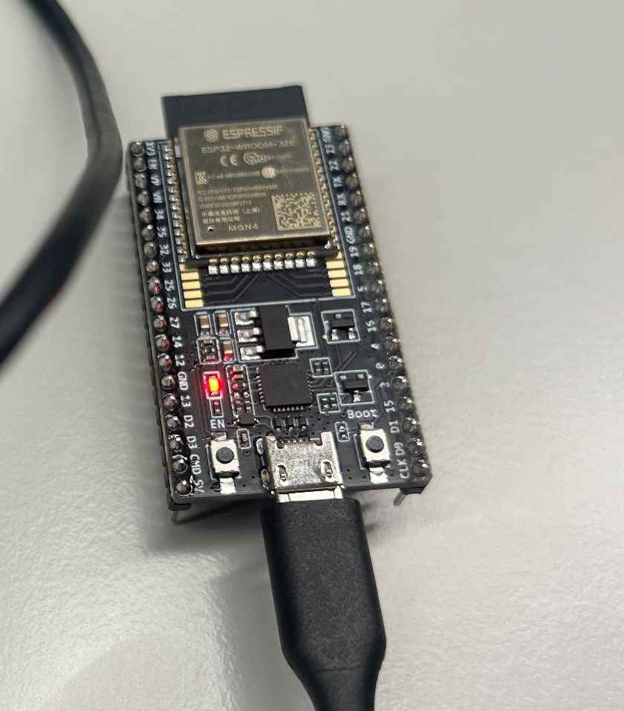
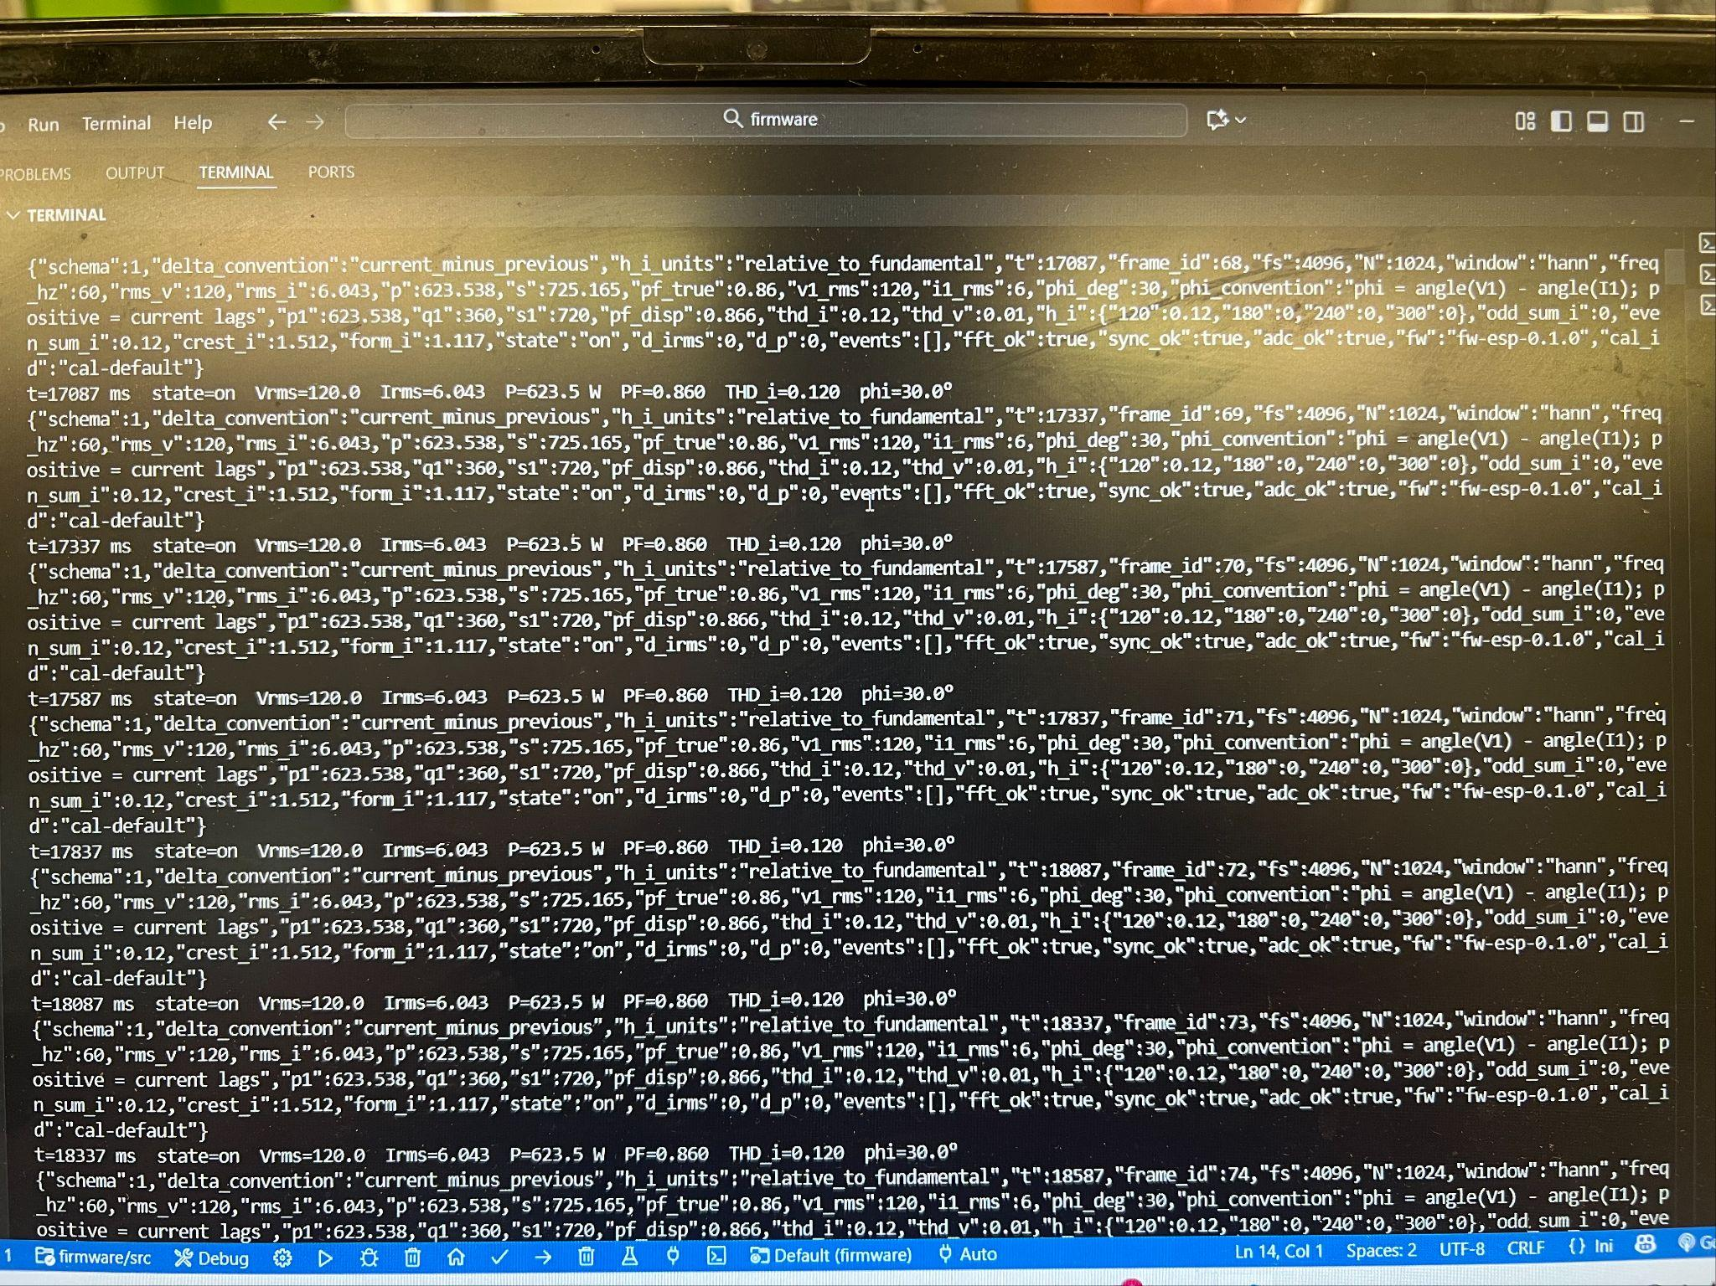
Embedded Systems Caiden Rueben
Designed: Embedded firmware architecture replicating Python DSP sandbox (RMS, PF, THD, harmonics).
Built: Fully functional C++ implementation running on ESP32; validated output consistency.
Tested: Confirmed accurate power calculations and periodic telemetry frame generation; stable operation over continuous runtime.
Next: Wireless telemetry transmission, NTP timestamping, and integration with application layer.
Firmware running simulated voltage/current telemetry for Home Power Monitor prototype.

Slide 11
Machine Learning
Joshua Le
Accomplishments since midterm update ~32 Hours | Ongoing progress/problems and plans until the next presentation
Processed the high-frequency PLAID dataset to engineer a 10-feature "fingerprint" for 1,074 unique appliance events. tuned Random Forest via RandomizedSearchCV; hold-out results Acc ≈ 0.98; saved artifacts (classification_report.json). Packaged the final, tuned model into a lightweight, production-ready Flask API and containerized it with Docker. | Deploying the containerized model API to a live cloud environment Testing and debugging the end-to-end data pipeline by integrating the live API with the hardware and the Flutter app to ensure the JSON formats match and predictions are displayed correctly. Designing the /feedback API endpoint and database logic to allow the app to send back user-corrected labels, which will be used for future model retraining.

Slide 12
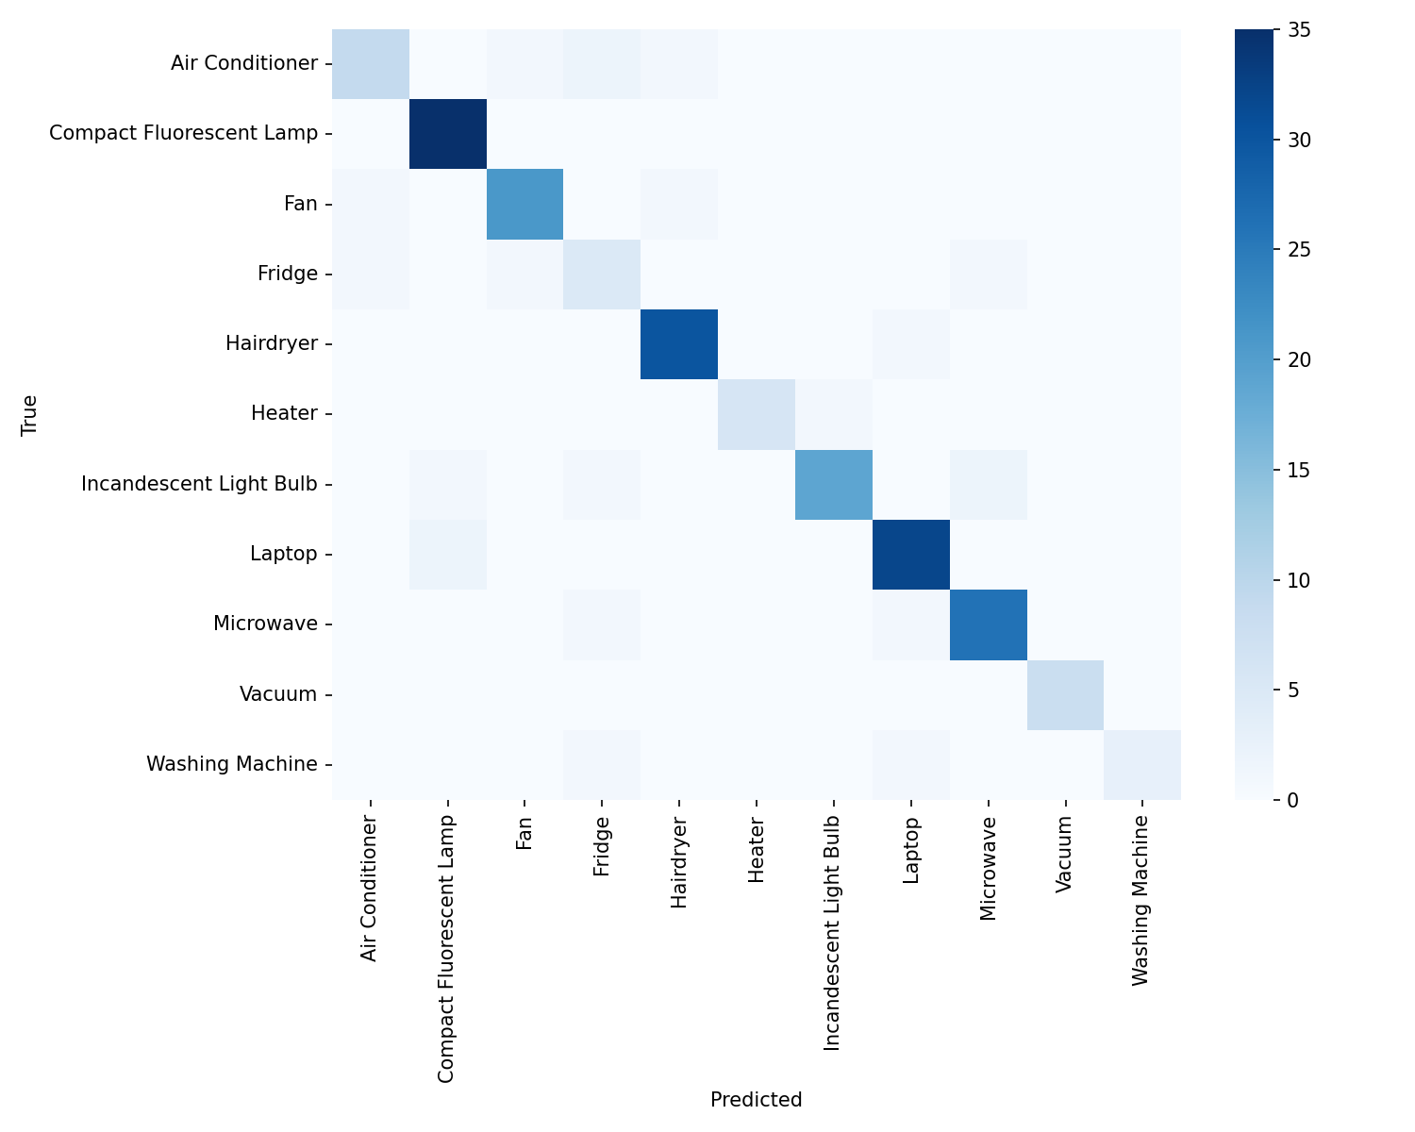
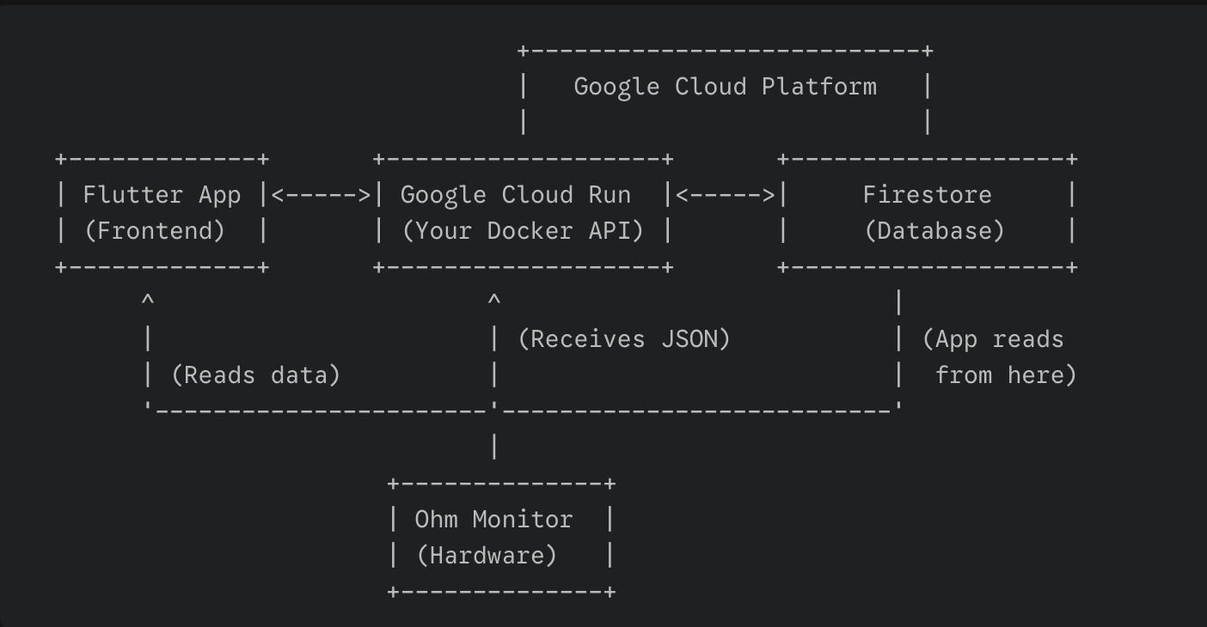
Machine Learning
Joshua Le

Slide 13
App Development
Vivek Samuel
Accomplishments since midterm update 25 hrs of effort | Ongoing progress/problems and plans until the next presentation
Built a live data pipeline connecting the Flutter app to a real-time Firebase database. Created a 3-tab app that displays live-updating power, historical charts, and appliance status. Developed a hardware simulator that mimics both DSP and ML subsystems to feed the cloud. | Complete the 'Appliances' tab by connecting it to the simulated ML data feed. Implement cost analysis: users will input their price-per-kWh to see energy costs. Begin designing user authentication and secure, per-user data architecture for the final product.

Slide 14
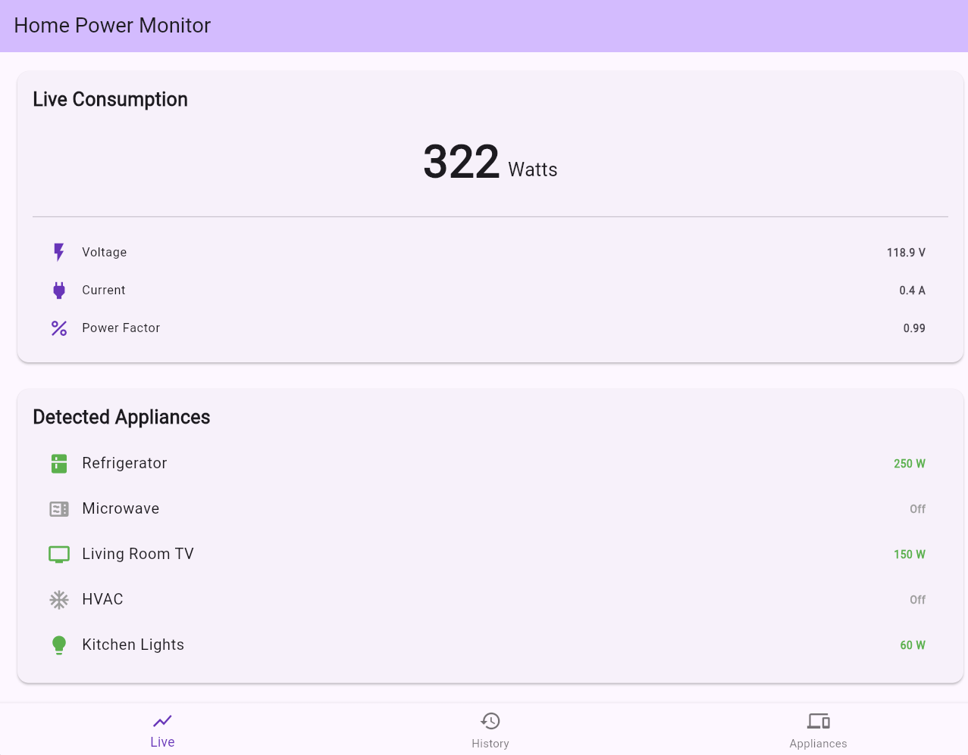
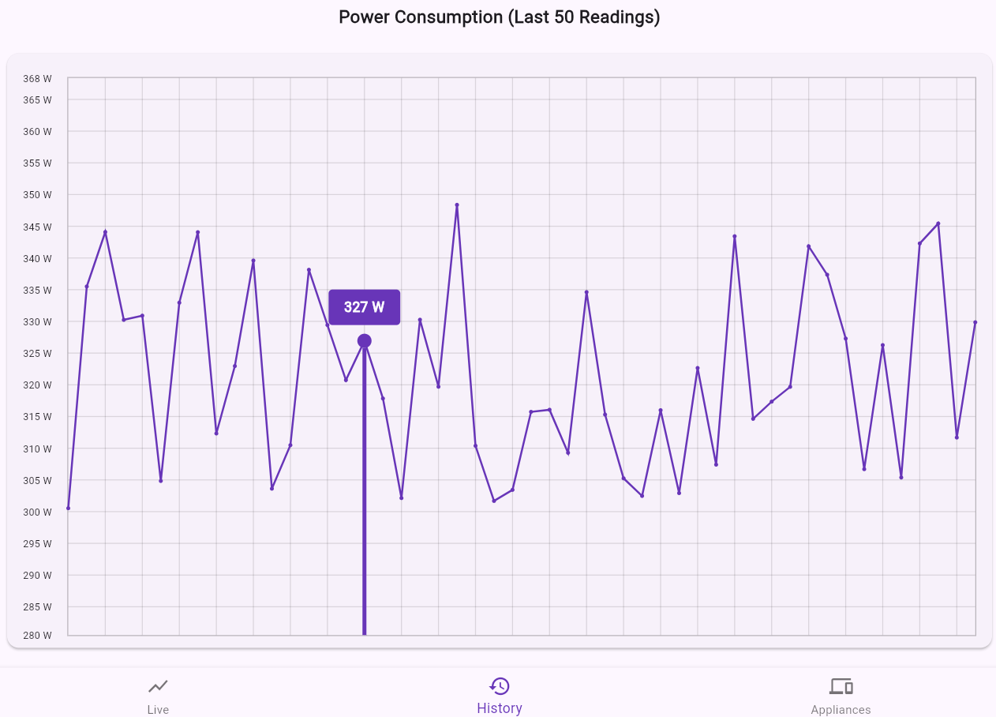
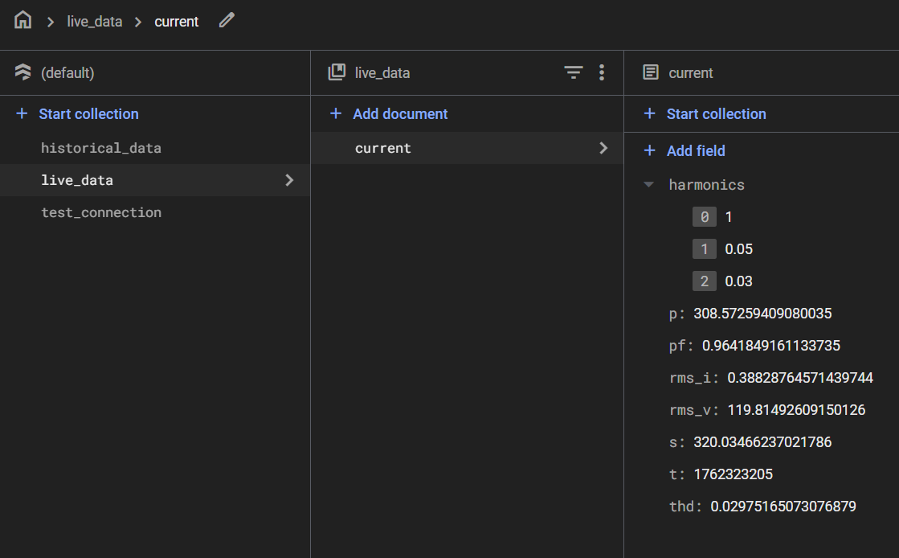
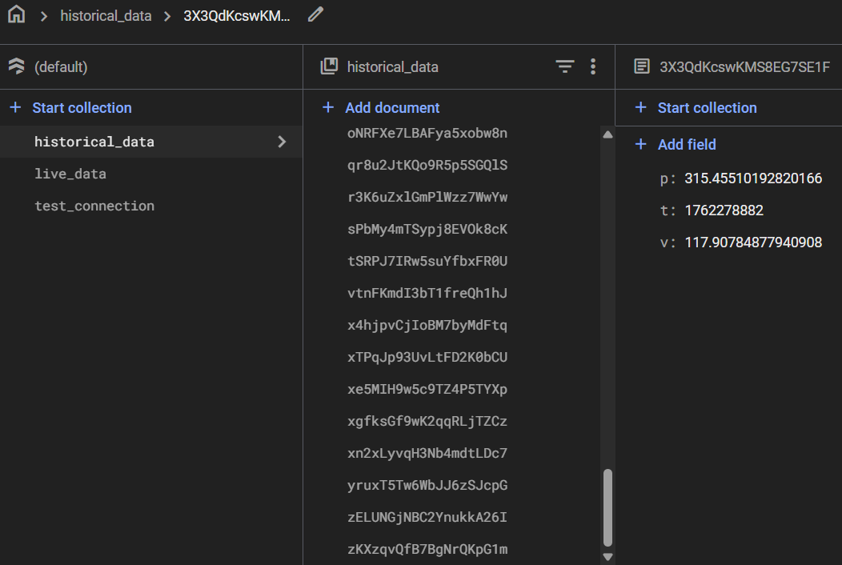
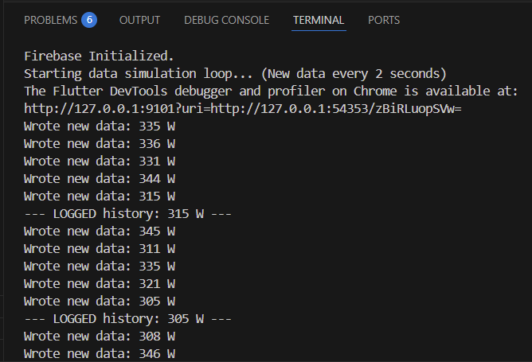
App Development
Vivek Samuel
Designed: A decoupled architecture using Firebase as the central, real-time data hub.
Built: A 3-tab Flutter app and a parallel hardware simulator to populate the cloud database.
Tested: Verified the complete end-to-end pipeline: Simulator (write) -> Cloud (update) -> App UI (display).

Slide 15
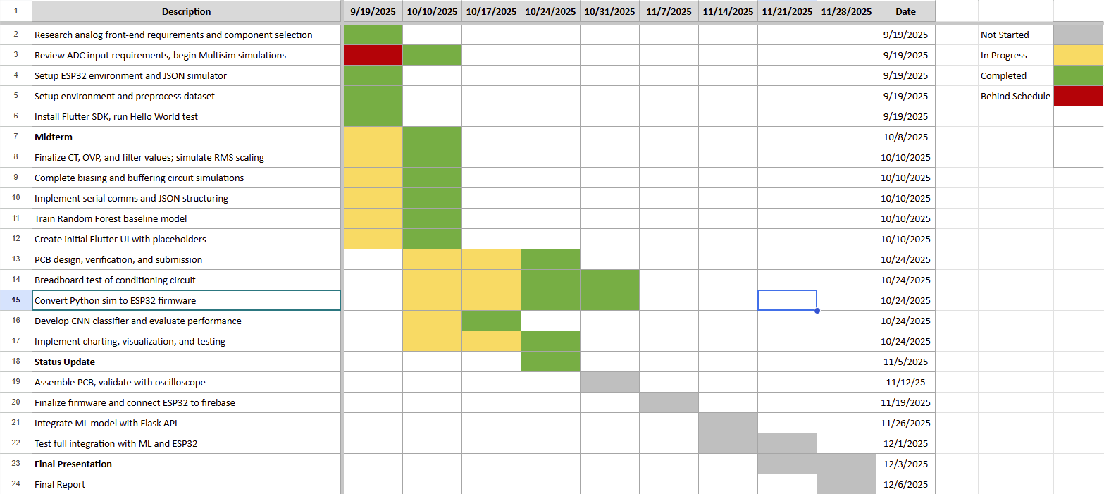
Project Execution

Slide 16
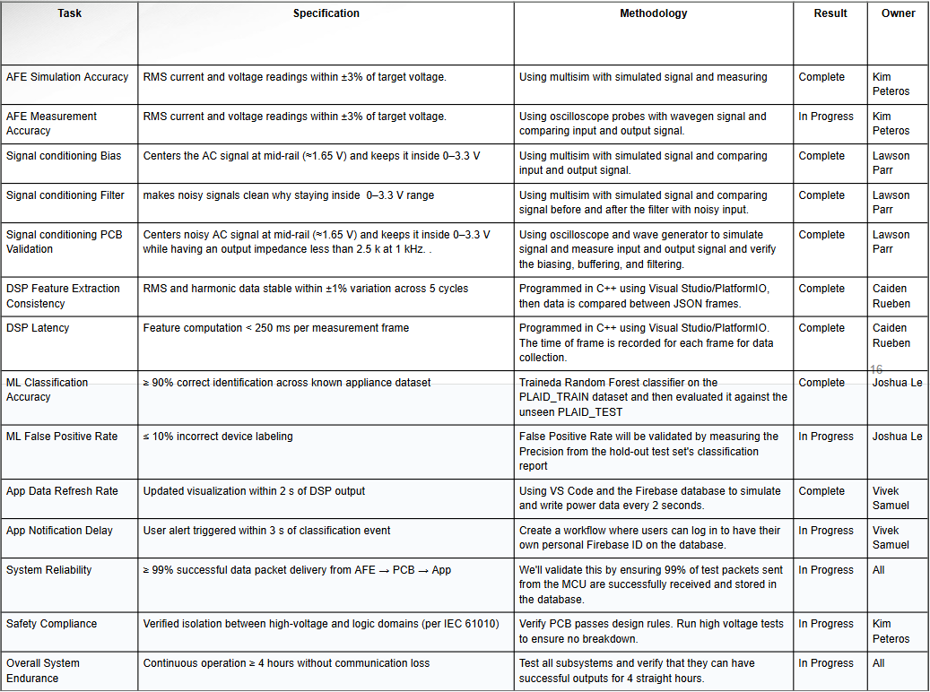
Project Validation

Slide 17
Thank you for your time, we will be opening the floor for questions!

